Slide 1
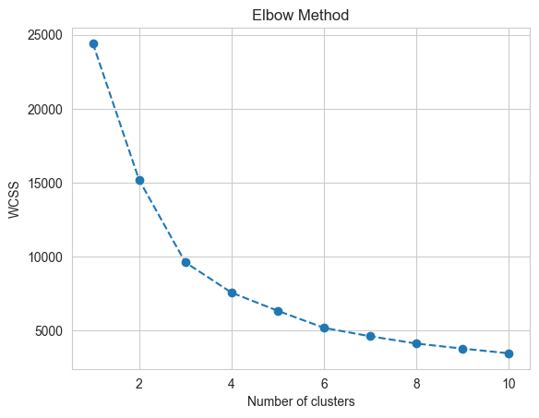
Clustering Evaluation – Elbow plots
Optimal clusters are at the point in which the knee "bends" or in mathemetical terms when the marginal total within sum of squares ("wss") for an additional cluster begins to decrease at a linear rate.
Probably not 3 clusters, but after 4-5 clusters the inertias do seem to decrease linearly.

Slide 2
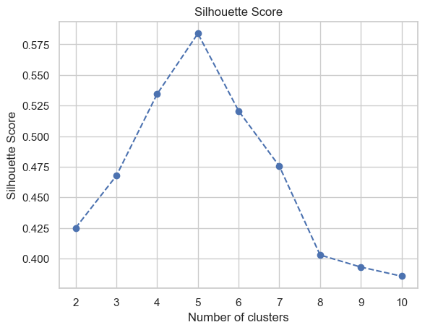
Clustering Evaluation – Silhouette score
Ratio of intra-cluster distances to inter-cluster distances.
Silhouette indices closer to 1 indicate points are well-matched and similar to other points in the cluster.

Slide 3
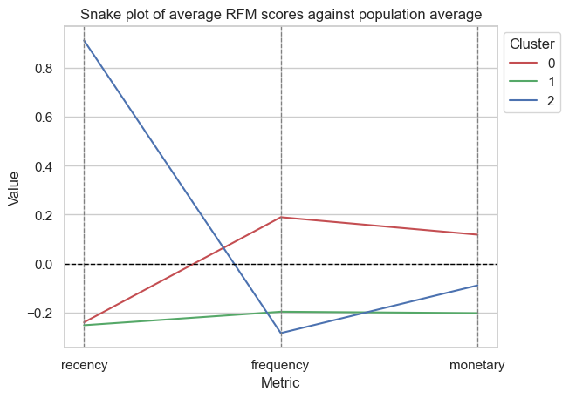
3 Clusters

Slide 4
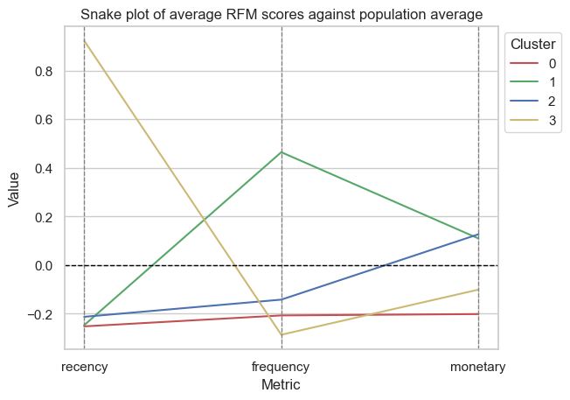
4 Clusters
Only 1 segment of customer (cluster 1) that spends more frequently on average.
This same customer segment has a higher monetary spend compared to the population average as with cluster 2.
Cluster 0 are low spenders who shop infrequently, less recently and lower average spend compared to the population average.
Cluster 3 segment of customers – spent very recently i.e. towards end of the year but less frequently overall and with lower average spend.

Slide 5
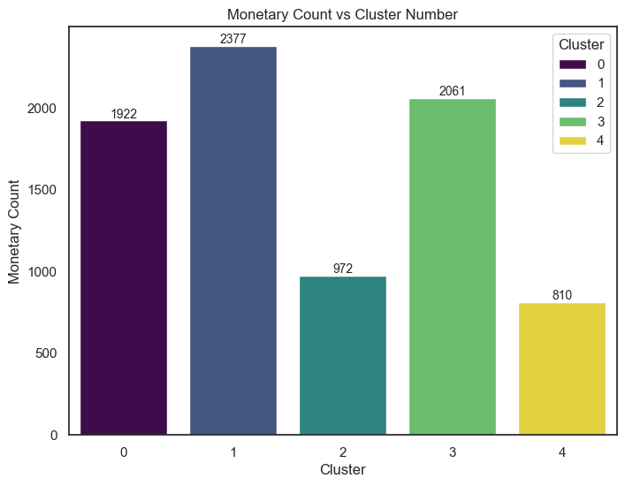
5 Clusters
Most individuals in core clusters 0, 2 and 3.
Minor clusters in 2 and 4.
2 core clusters and 2 minor clusters.

Slide 6
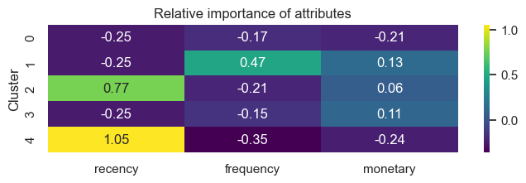
5 Clusters
Low spread around monetary spend.
Many customers are relatively infrequent spenders with one cluster where frequency of transactions is high.
2 Clusters with highly above average recency – spending very close up until the end of the year.

Slide 7
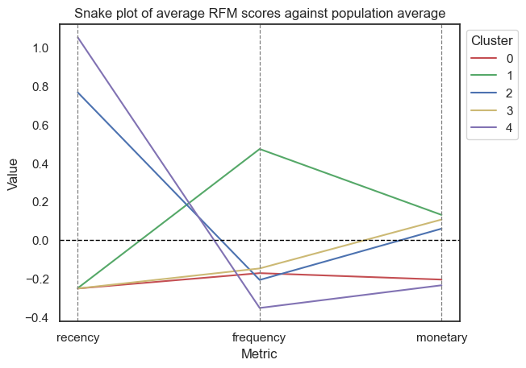
5 Clusters
Major clusters (0,1,3)
0: Below average on all metrics.
1: Above average frequency and monetary spend, low recency.
3: Below average recency and frequency and average/slightly above average monetary spend.
Very large group of people.
Minor clusters (2,4)
2: Below-average frequency, average monetary spend and high recency.
4: Below average frequency, average monetary spend but low recency.
Minor clusters are quite similar apart from the fact that they differ on how recently they have made transactions.

Slide 8
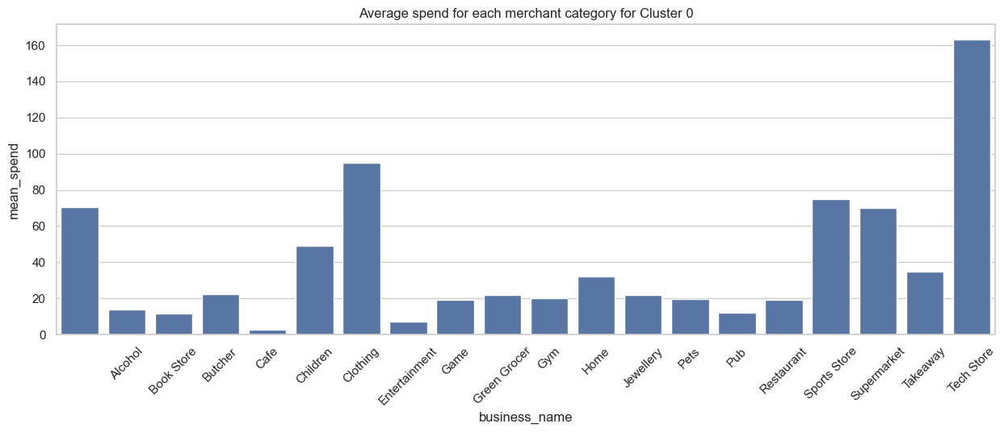
Spending behaviours for each customer segment

Slide 9
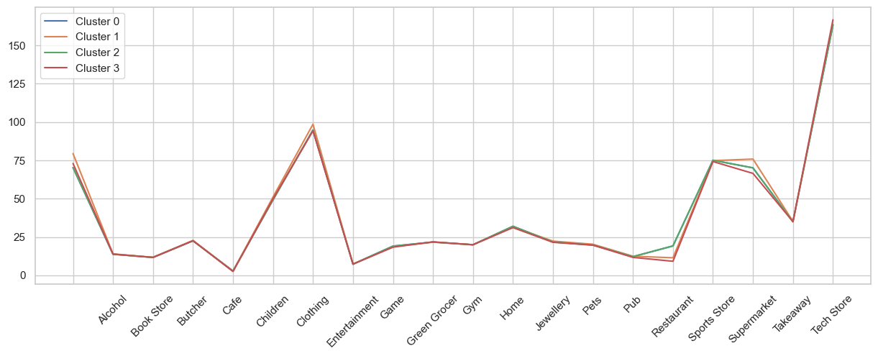
Spending behaviours for each customer segment – 4 clusters

Slide 10
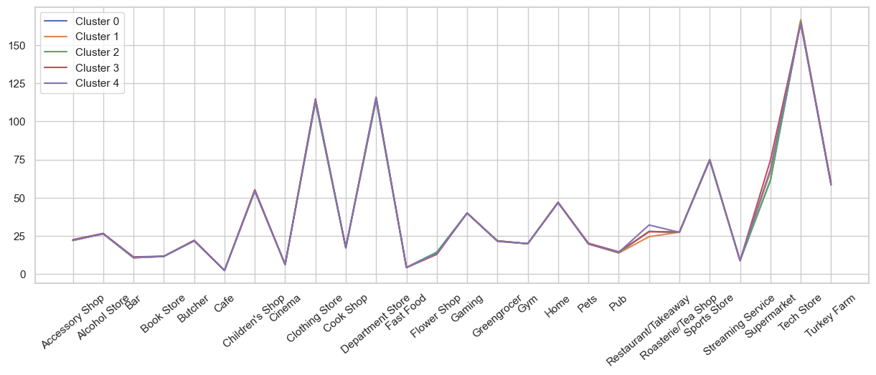
Spending behaviours for each customer segment – 5 clusters

